Slide 1
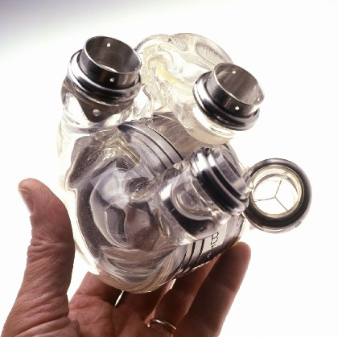


Slide 2
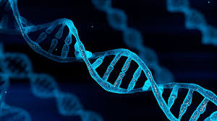
Genetic diseases
Awareness, Screening, and Public health
in Shanghai
Sam 12/12
EAP: The Greater Good

Slide 3
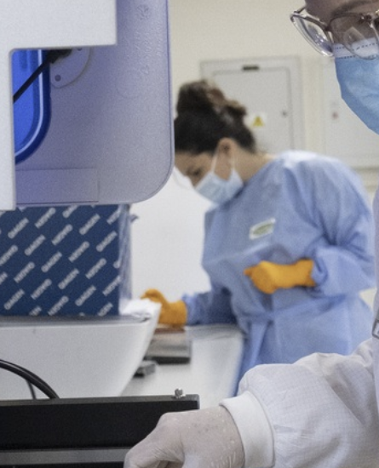
Agenda
Research
Experiential Learning Process
Key Findings
Conclusion

Slide 4
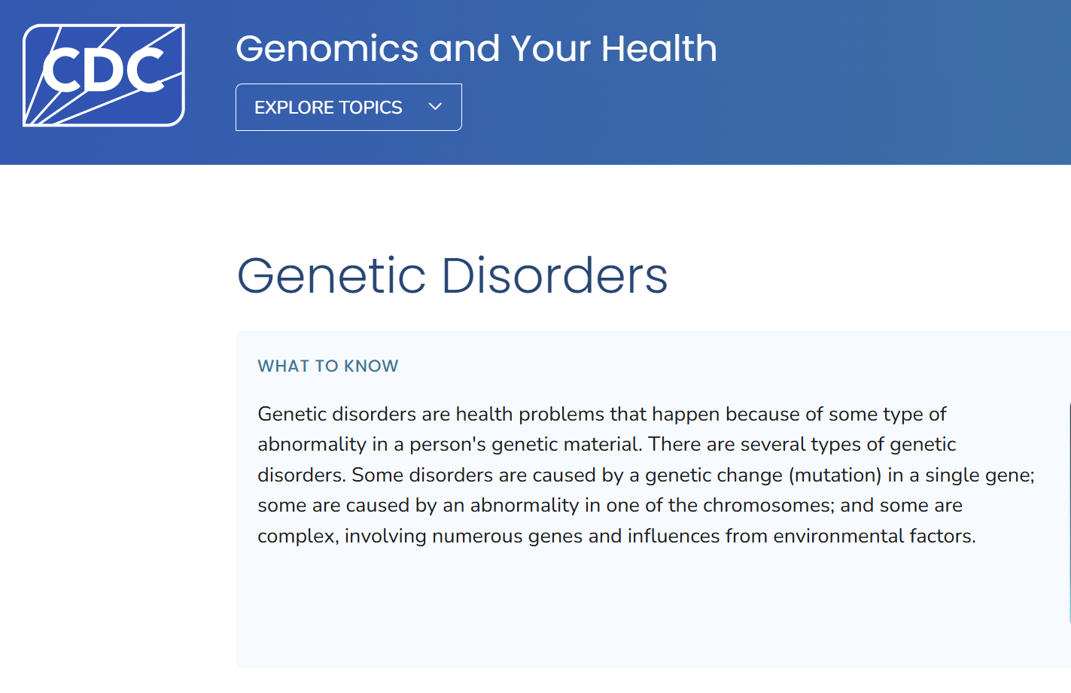
Research
Genetic Disorders
-Health problems caused by genetic abnormality
(Genetic Disorders,CDC,2024)

Slide 5
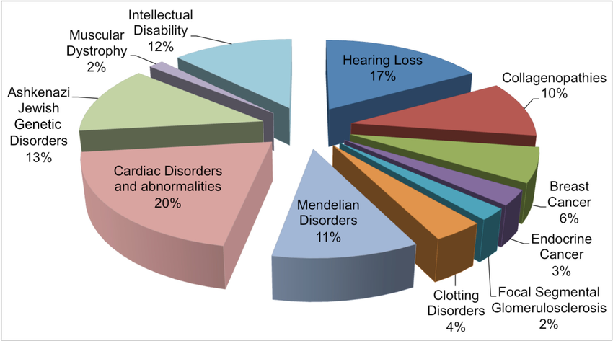
Macro perspective
(Delio,2023)

Slide 6
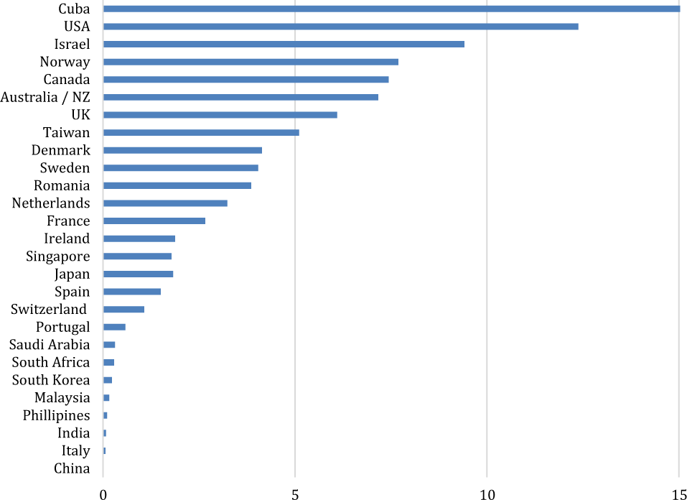
Macro perspective
Trained genetic counselors per million
population
(Abacan, M., Alsubaie, L., Barlow-Stewart, K.
2019)

Slide 7
Micro perspective
Genetic awareness in Shanghai
Public awareness on genetic testing remains limited
Insufficient genetic literacy
(Likhanov et al., 2023)

Slide 8
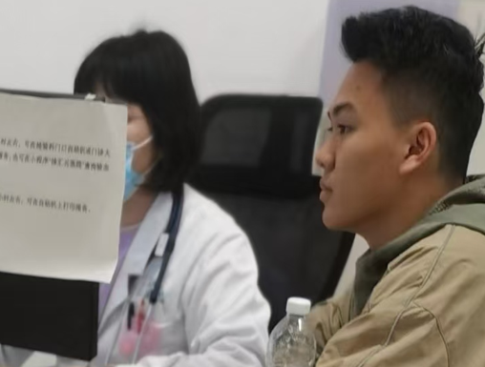

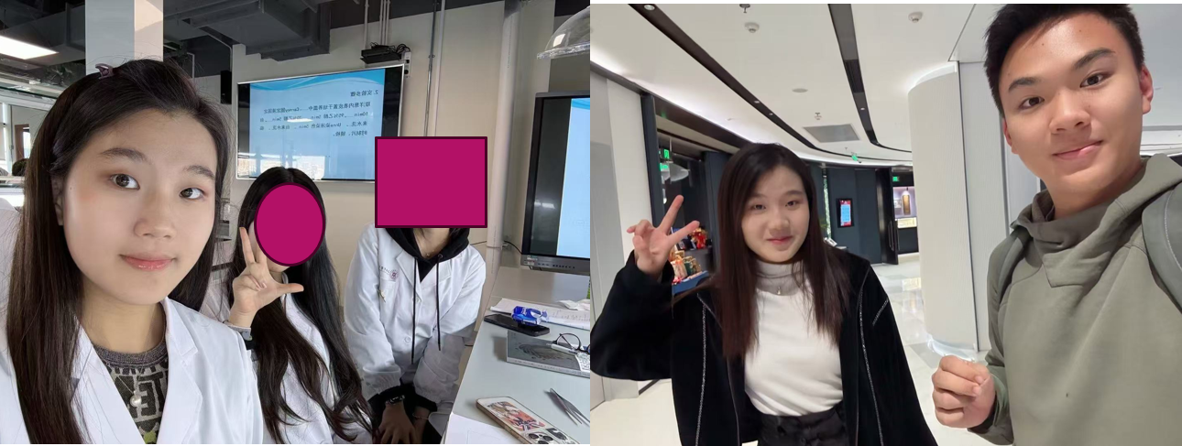
ELP Introduction
12/1
RuiJing
Hospital
Dr. Liu
Interviewing a genetic counsellor
Heart-to-Heart voluntary service
Interviewing a physician
11/29
Zhong Shan Hospital
12/3 Yodak Cardio Hospital

Slide 9
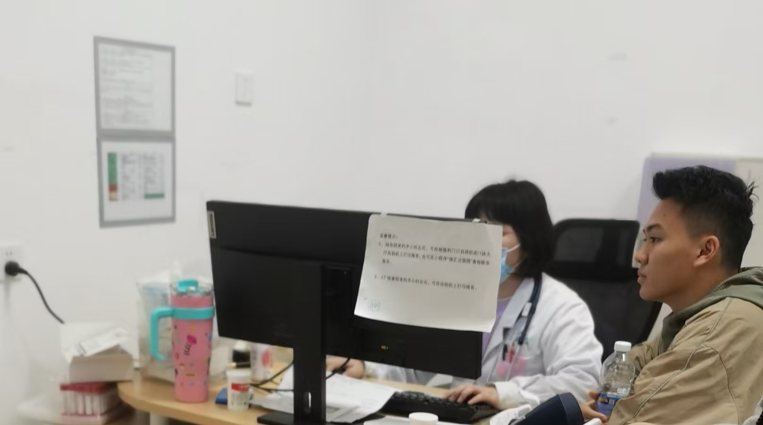


Experiential Learning Process
An interview with Genetic counsellor
Key points:
1) Importance of prenatal tests
2) Genetic awareness education
and wide scale genetic testing
> Doctor Yanli Liu specializes in prenatal diagnosis and fetal medicine, including prenatal diagnosis and genetic counseling, management and intrauterine therapy

Slide 10
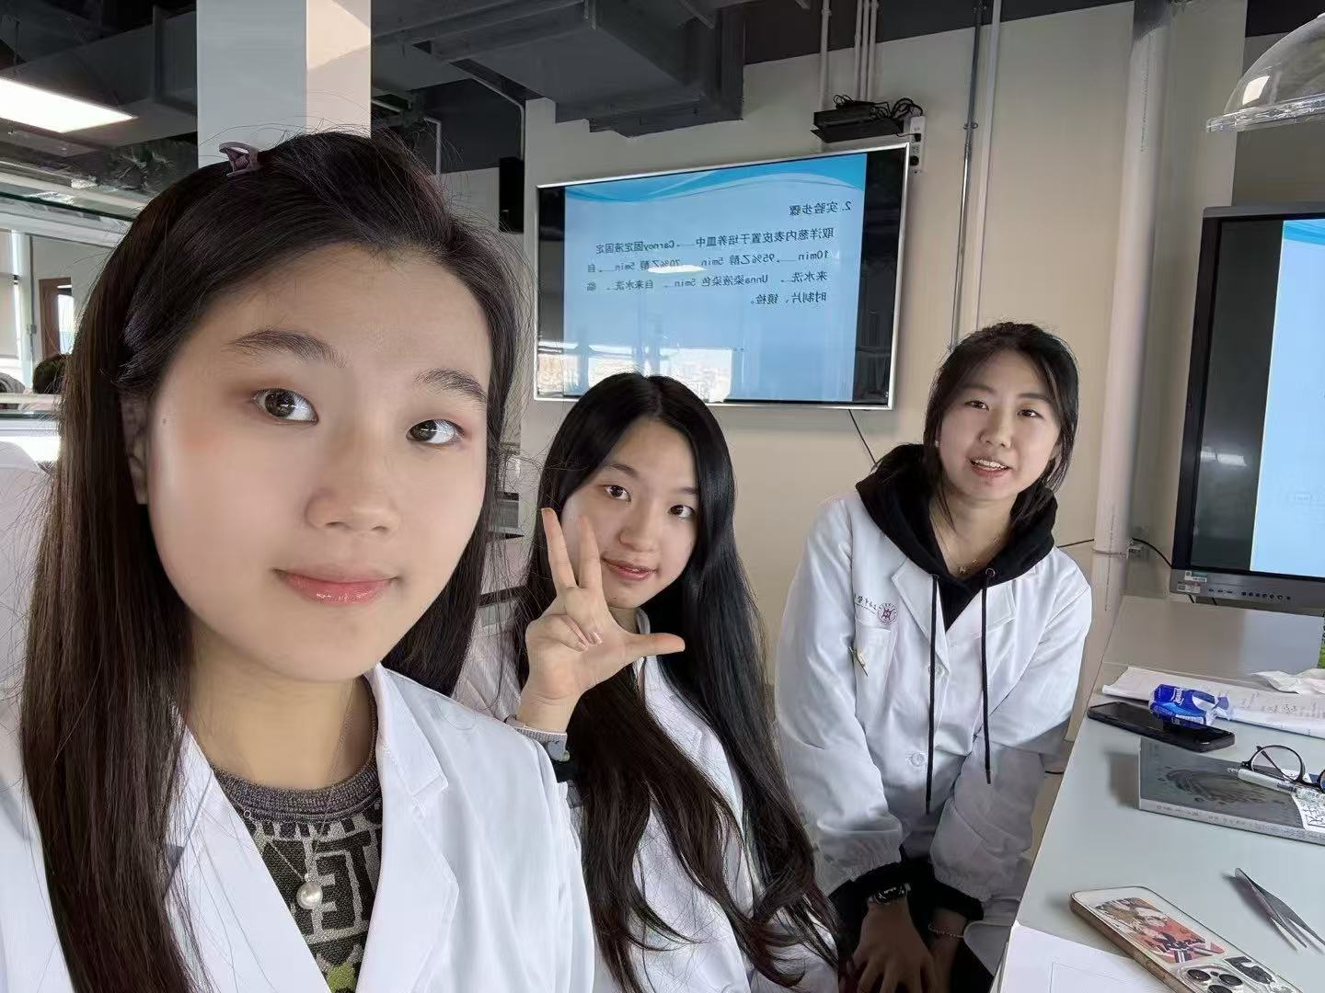

Experiential Learning Process
Interview with a physician(cousin sister)
Key points:
Neglectful behaviors

Slide 11

Experiential Learning Process
Volunteering at Heart-to-heart
（location: 远大心胸医院）
Key points:
Unaffordable surgeries and medicines
2) Always be supportive and kind
to the patients

Slide 12
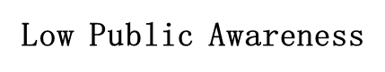



Key findings
How does ELP outcomes relates to previous researches?
Previous Research | Genetic Counsellor | Physician
 | ✔ | ✔
✔
(Abacan, M., Alsubaie, L., Barlow-Stewart, K.2019)
(Likhanov et al., 2023)

Slide 13
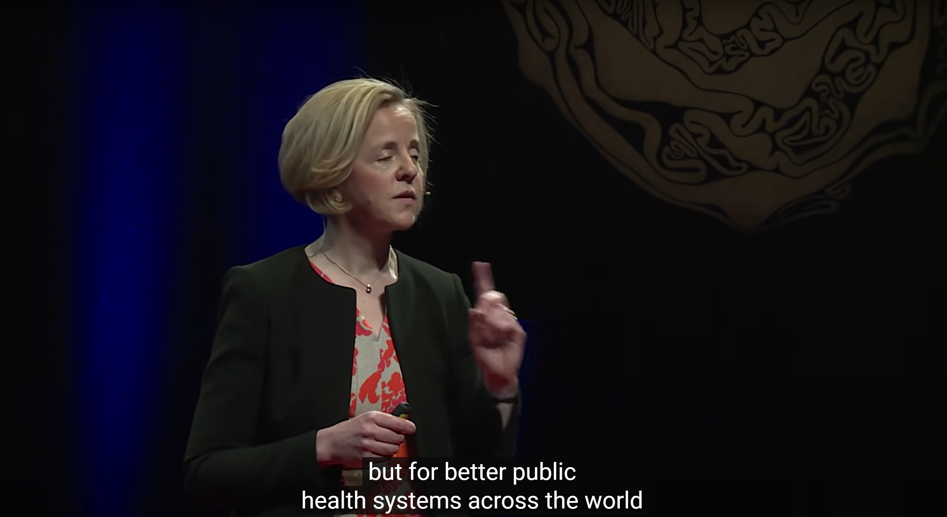
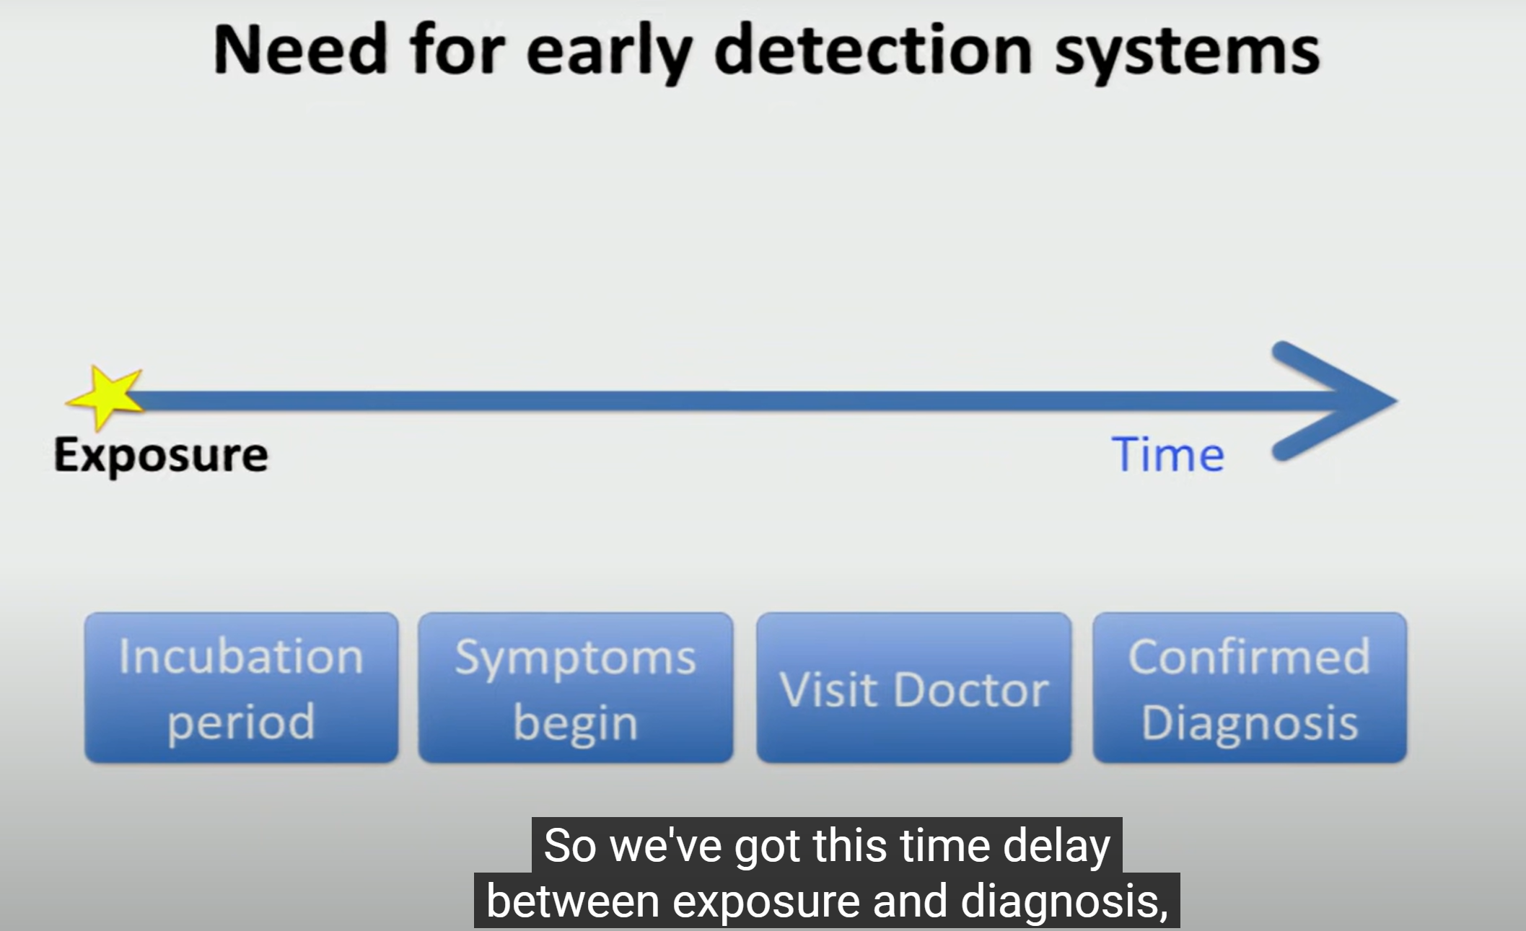


Key findings
Through GG lens(Racheal McKendry)
How do genetic diseases relate to public health?
>Prevention and Early Detection

Slide 14
Genetic diseases heavily impact public health by consuming significant medical resources and straining healthcare systems. As Rachel McKendry highlights, early warning systems are crucial for preventing diseases and saving lives. In the context of genetic diseases, genetic screening serves as this warning system. According to genetic counselor Mrs. Liu, prevention and early detection can mitigate severe outcomes, lower long-term healthcare costs, and ease the burden on public health systems.

Slide 15
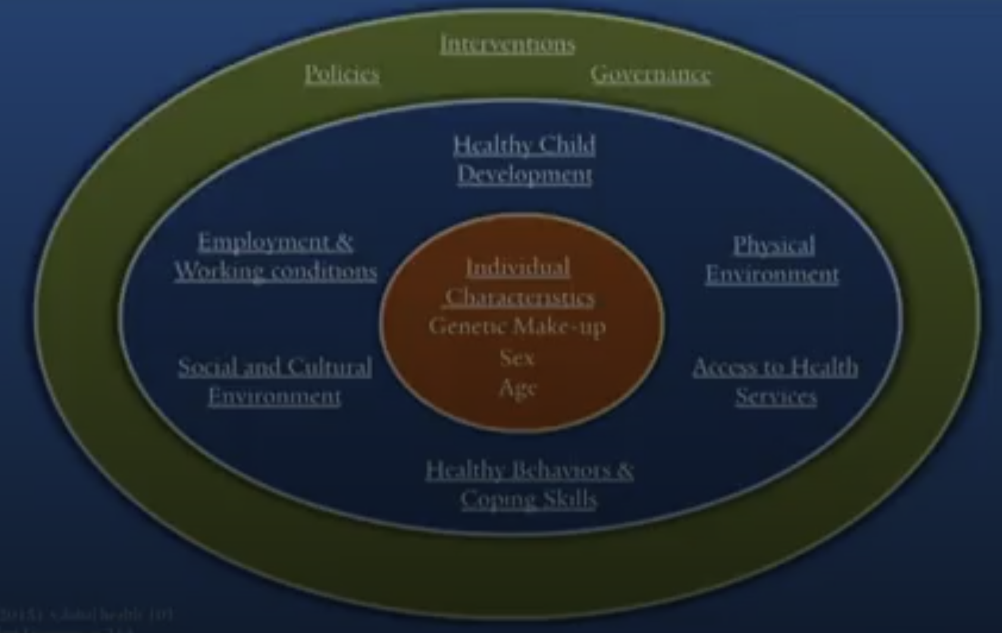
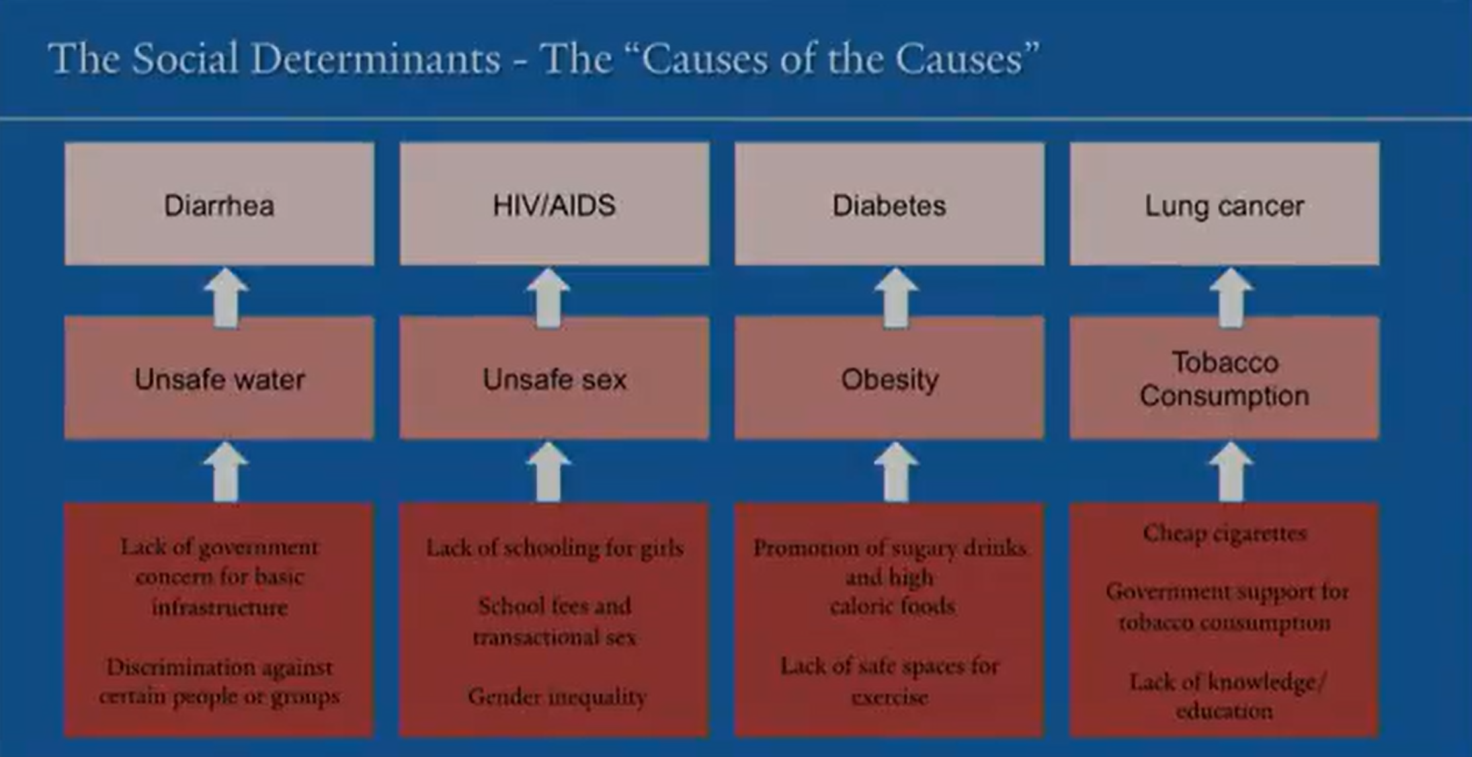
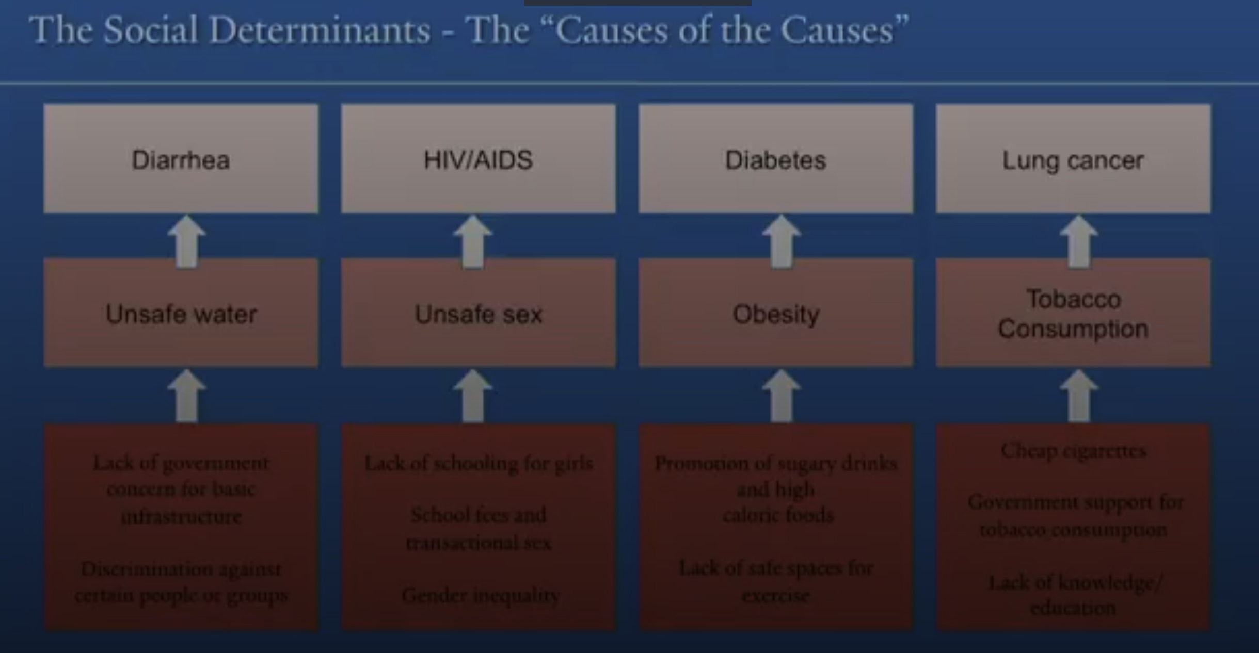
Key Findings
(Skolnik, Risk Factors and Social Determinants)

Slide 16
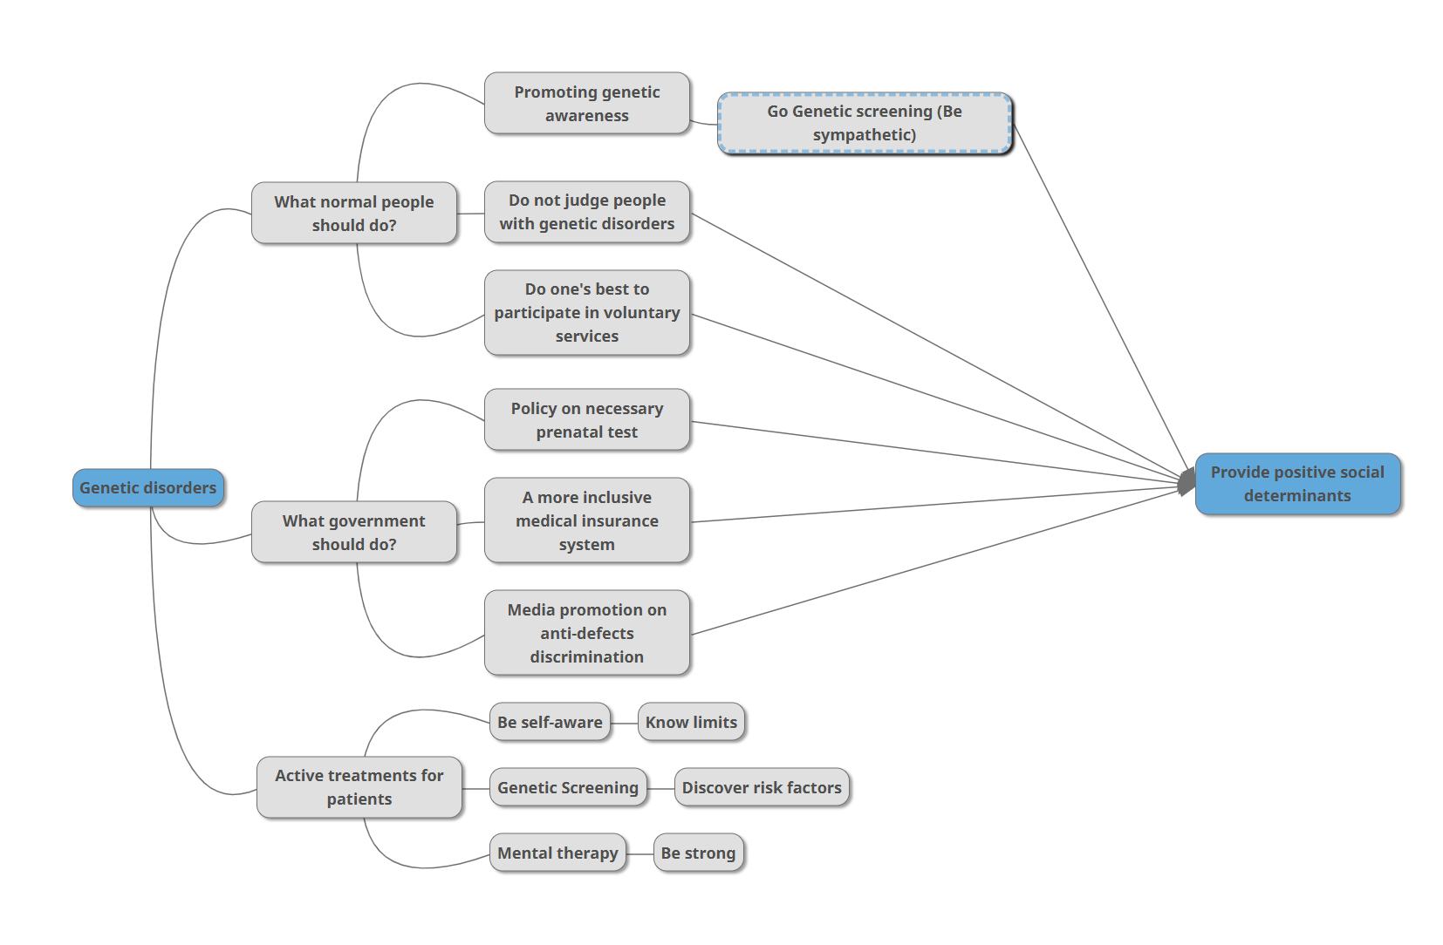

Slide 17



Conclusion
Early genetic screening
medical reforms
collective kindness
Bright Future for genetic
diseases patients
Raising genetic awareness

Slide 18
In conclusion, early genetic screening, medical reforms, and collective kindness represent critical pillars for a brighter future for patients with genetic diseases. By prioritizing preventive measures like genetic counseling and awareness, governments, healthcare providers, and communities can reduce the emotional, financial, and systemic burden these conditions impose. This unified approach not only improves patient outcomes but also strengthens public health systems, paving the way for a more inclusive and supportive society where every individual has the opportunity to thrive.

Slide 19
Reference
Genetic disorders. (2024, May 15). Genomics and Your Health. https://www.cdc.gov/genomics-and-health/about/genetic-disorders.html
Delio, Maria, et al. “Development of a Targeted Multi-Disorder High-Throughput Sequencing Assay for the Effective Identification of Disease-Causing Variants.” PLOS ONE, Public Library of Science
Abacan, M., Alsubaie, L., Barlow-Stewart, K. et al. The Global State of the Genetic Counseling Profession. Eur J Hum Genet 27, 183–197 (2019). https://doi.org/10.1038/s41431-018-0252-x
Likhanov, M., Zakharov, I., Awofala, A., Ogundele, O., Selita, F., Kovas, Y., & Chapman, R. (2023). Attitudes towards genetic testing: The role of genetic literacy, motivated cognition, and socio-demographic characteristics. PLoS ONE, 18(11)

